Slide 1

Problem Statement and Team Details
Problem Statement: Safety Object Detection - multiclass detection (7 classes) for operational safety.
Team Name: HackOverflow
Team Leader Name: Ch. Srikrishna Vardhan
Institute Name: KLH University, Bachupally Campus
Team Leader Email ID: chiluverusrikrishnavardhan@gmail.com
Repository Link: https://github.com/HackOverFlow-HackWithIndia/Safety-Object-Detection---multiclass-detection-7-classes-for-operational-safety

Slide 2
Problem and Solution
Safety-critical equipment must be quickly identifiable in emergencies.
Missing or misidentified objects → serious risks to operations.
Manual inspection = slow, error-prone, not scalable.
Challenge: Automatically detect and classify 7 safety objects with high accuracy.
Goal: Build a real-time detection system suitable for deployment in safety-critical environments.

Slide 3
Methodology & Implementation
Data Preparation
7 safety object classes in YOLO format (images + labels).
Train/validation split (80/20).
Preprocessing & Augmentation
Resize to 640×640.
Flips, scaling, rotation, mosaic, color jitter.
Model Selection
YOLOv8m baseline (accuracy vs speed balance).
Pretrained weights (transfer learning).
Training Setup
Optimizer: AdamW, LR scheduler.
Epochs: 50, Batch: 16.
Metrics: mAP@0.5, mAP@[0.5:0.95], Precision, Recall.
Evaluation & Results
Per-class AP for 7 categories.
Visual inspection of detections & failure cases.
Deployment & Inference
Best weights exported (best.pt).
Real-time inference pipeline for images/videos.
Ready for edge (Jetson Nano) & cloud deployment.

Slide 4
Technology Used
Programming Language
Python 3.10
Frameworks & Libraries
PyTorch (Deep Learning)
Ultralytics YOLOv8 (Object Detection)
OpenCV (Image Processing)
NumPy, Pandas, Matplotlib (Data Handling & Visualization)
Tools & Platforms
VS Code (Development)
Jupyter Notebook (Experiments & EDA)
GitHub (Version Control & Collaboration)
Weights & Biases (Experiment Tracking, optional)
Hardware
NVIDIA GPU (CUDA-enabled) for training
CPU/Edge Devices (Jetson Nano, Raspberry Pi) for deployment
Pipeline Flow
Data → Preprocessing → Training → Evaluation → Inference → Deployment

Slide 5
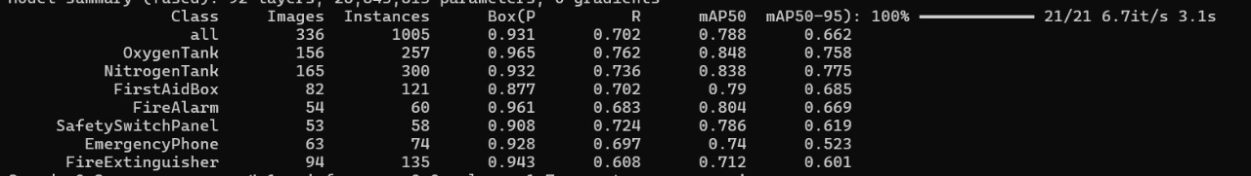
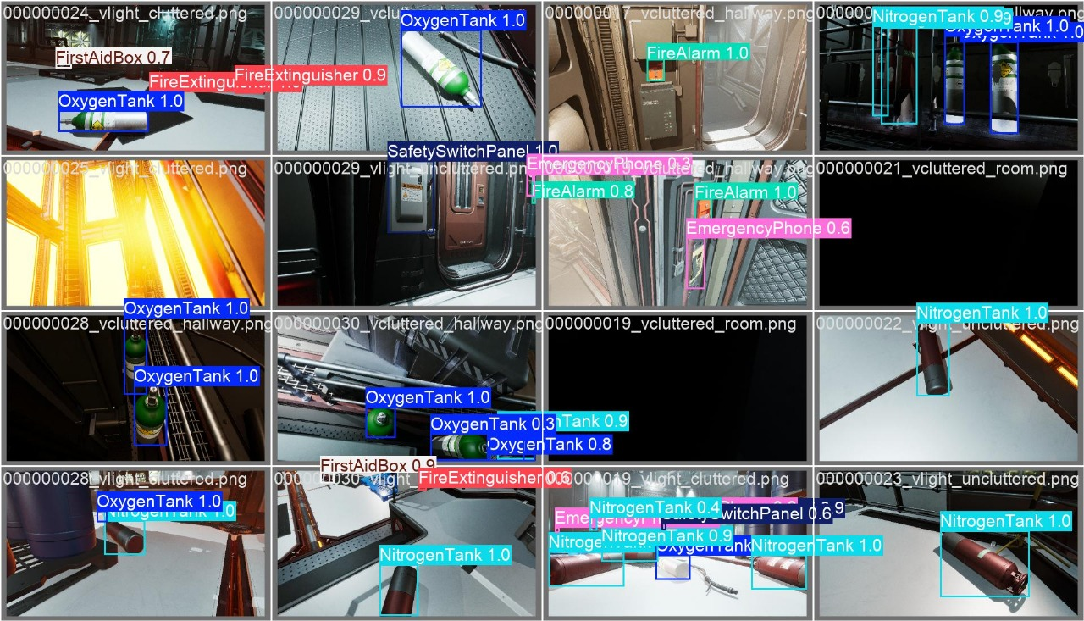
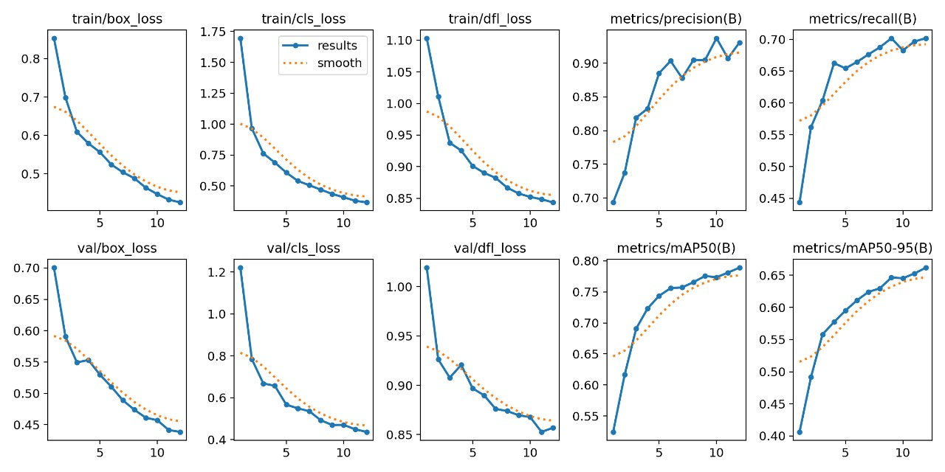
Flowchart & Supporting Images

Slide 6
Feasibility and Market Use
Feasibility
Model size optimized (<50 MB) → easy deployment.
Runs on edge devices (Jetson Nano, Raspberry Pi) and cloud servers.
Supports real-time inference (~20 FPS on mid-tier GPU).
Scalable pipeline → can be retrained for new safety objects.
Compatible with standard CCTV/IP camera feeds.
Market Use Cases
Space Missions → monitor equipment safety onboard stations.
Industrial Plants → ensure compliance with safety regulations.
Smart Surveillance → auto-alert systems for fire/safety hazards.
Manufacturing Units → continuous monitoring of safety gear placement.
Public Infrastructure → airports, metros, and malls for safety preparedness.

Slide 7
Conclusion
Built a 7-class safety object detection model using YOLOv8.
Achieved strong results on mAP, Precision, Recall.
Provides real-time detection of safety-critical equipment.
Designed a pipeline that is scalable, lightweight, and deployable.
Potential to improve safety monitoring in space, industry, and public infrastructure.

